Slide 1
Network Layer Protocol

Slide 2
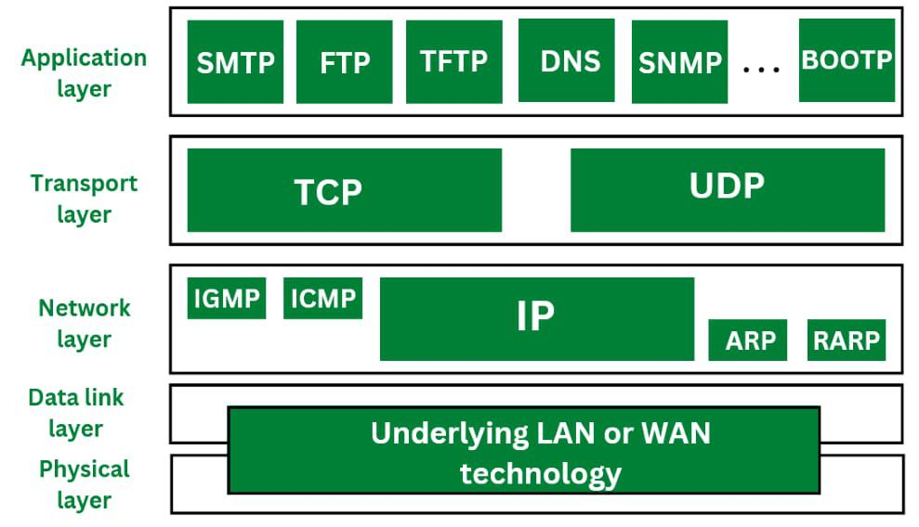

Slide 3
Internet Protocol
Data transmitted over an internet using IP is carried in messages called IP datagrams.
Like all network protocol messages, IP uses a specific format for its datagrams.

Slide 4
Internet Protocol
The IPv4 datagram is conceptually divided into two pieces:
the header
the payload

Slide 5
Internet Protocol
The header contains addressing and control fields, while the payload carries the actual data to be sent over the internetwork.
Unlike some message formats, IP datagrams do not have a footer following the payload.

Slide 6
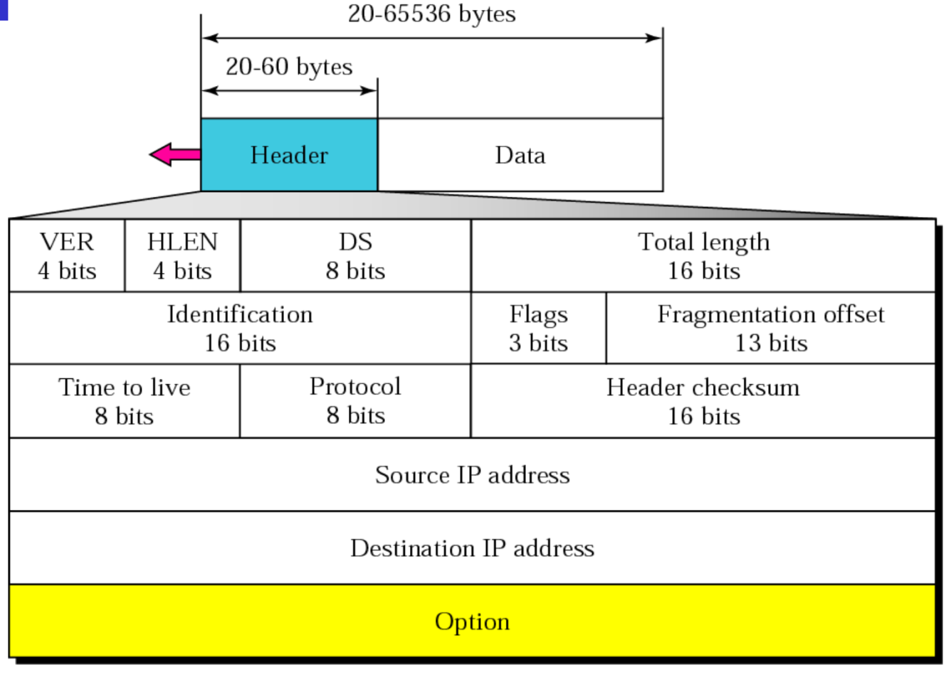
IP Datagram

Slide 7
IP Datagram
Version: This 4-bit field defines the version of the IP protocol
Header Length(HLEN): This 4-bit field defines the total length of the datagram header in 4 byte times.

Slide 8
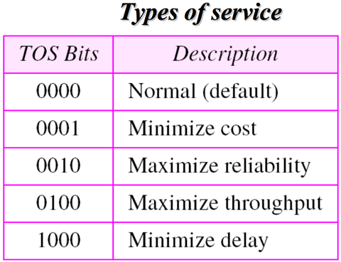
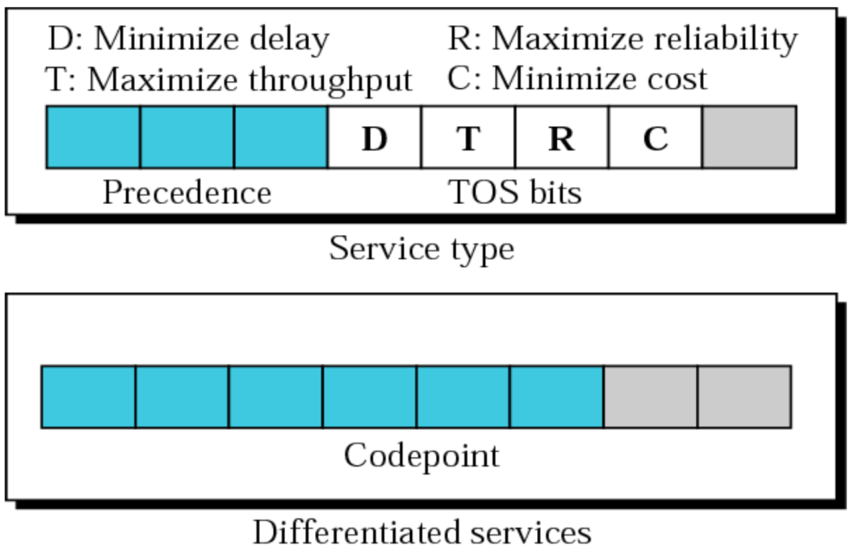
IP Datagram
Differentiated services(DS):

Slide 9
IP Datagram
Service type:
The first 3-bits are called precedence bits.
The 4-bits are called TOS bits.
The last bit is not used.

Slide 10
IP Datagram
Service type:
The first 3-bits are called precedence bits.
The 4-bits are called TOS bits.
The last bit is not used.

Slide 11
IP Datagram
Precedence bits: It is a 3-bit subfield ranging from 000 to 111. The precedence defines the priority of the datagram in issues such as congestion.
Type of service (TOS) bits: We have 5 different types of service resolved by application programs.

Slide 12
IP Datagram
Interactive activities
Activities requiring immediate attention.
Activities requiring immediate response need min delay.
Activities that send bulk data requiring max throughput.
Management activities need max reliability.
Background activities need min cost.

Slide 13
IP Datagram
Total length: This is a 16-bit field that defines the total length(Header + data) of the IP datagram in bytes.
Time to live(TTL): Today this field is mostly used to control the max number of hops visited by the datagram.

Slide 14
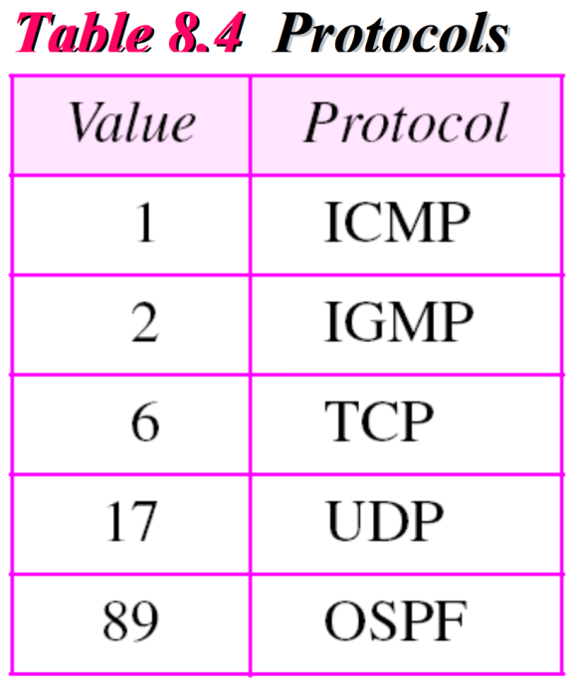
IP Datagram
Protocol: This 8-bit field defines the high level protocol that uses the services of the IP layer.

Slide 15
IP Datagram
Header checksum: This used for error detection
Source IP address: This field contains source machine IP address
Destination IP address: This field contains destination machine IP address

Slide 16
Interior Gateway Protocols

Slide 17
ARP
ARP stands for Address Resolution Protocol.
ARP is used to convert the logical address i.e. IP address into physical address i.e. MAC address.

Slide 18
ARP Working
While communicating with other nodes, it is necessary to know the MAC address or physical address of the destination node.
If any of the node in a network wants to know the physical address of another node in the same network, the host then sends an ARP query packet.

Slide 19
ARP Working
This ARP query packet consists of IP address and MAC address of source host and only the IP address of destination host.
This ARP packet is then received to every node present in the network.

Slide 20
ARP Working
The node with its own IP address recognises it and sends it MAC address to the requesting node.
But sending and receiving such packets to know the MAC address of destination node it increases the traffic load.

Slide 21
ARP Working
Therefore in order to reduce this traffic and improve the performance, the systems that makes use of ARP maintain a cache of recently acquired IP into MAC address bindings.

Slide 22
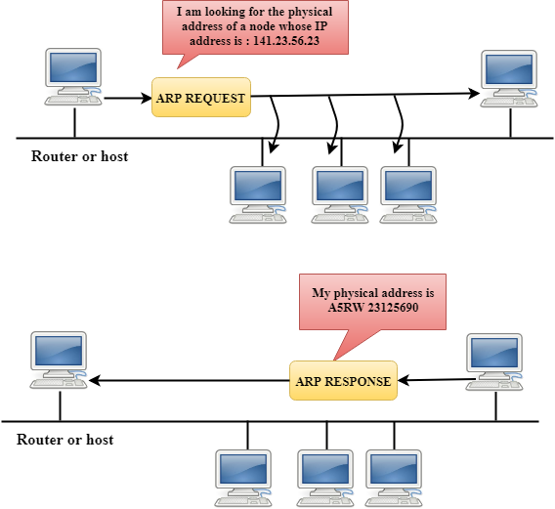

Slide 23
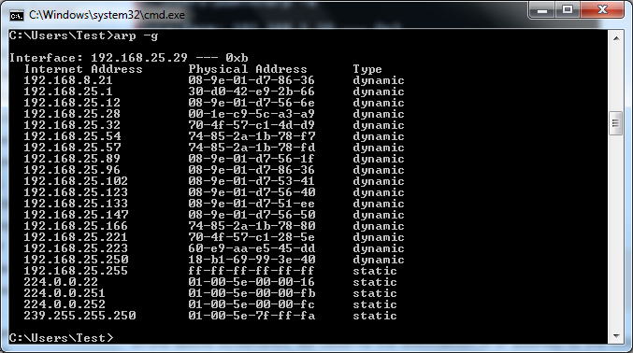

Slide 24
